Slide 1

Blood Bank Management Web Application
Presentation

Slide 2
TEAM MEMBERS
Name | Role
Bashamoni Shiva Kumar | Developer
Ashwith Thatipally | UI/UX Designer
Abhishek Singh | UI/UX Designer
Kellampalli Saathvik | Backend, APIs Integration & Deployment
Akash Aakula | Quality Assurance & Testing

Slide 3
Area | Tools | How it is used? | Why did we use?
Markup & Structure | HTML5 | Used to define the structure of the web application, including pages such as the homepage, donor registration form, hospital portal, admin panel, chatbot container, and other core sections. | Standard, semantic, and universally supported across browsers.
Styling & Ul | CSS3 (Custom Stylesheet) | Applied for layout design, color themes, responsiveness, role-based cards, tables, forms, floating chatbot interface, and public APl widgets to ensure a clean and user-friendly Ul. | Full design control without framework overhead.
Frontend Logic | JavaScript (Vanilla) | Implemented client-side logic such as form validation, dynamic table updates, Firebase interactions, public API calls, chatbot behavior, and dashboard interactivity. | Lightweight, simpler, and sufficient for project scope.
Authentication (BaaS) | Firebase Authentication | Used for secure Email/Password-based login and registration for Hospital and Admin users, handling authentication without building a custom auth backend. | Secure, ready-made authentication without backend complexity.
Database / Real-time Data | Firebase Firestore | Stores core application data including blood inventory, hospital blood requests, and hospital profiles. Enables real-time updates, especially for live blood availability on the homepage. | Real-time updates without managing servers.
Public Health Data (API) | Rootnet COVID-19 Hospitals & Beds API | Integrated a third-party public API to fetch live hospital and bed statistics by state, displayed as a hospital load or blood demand indicator on the homepage. | Real-time updates without managing servers.
Hosting & Deployment | Vercel | Used to deploy and host the static frontend (HTML, CSS, JS) and optionally manage serverless API endpoints such as /api/blood-inventory | Fast CI/CD and zero-config frontend deployment.
Version Control | Git, GitHub | Used for source code version control, tracking changes through commits and branches, maintaining a remote repository, and integrating with Vercel's CI/CD pipeline. | Reliable version control and collaboration.
Development Environment | VS Code, Ubuntu (VirtualBox), Terminal/Shell | VS Code used as the primary editor: Ubuntu Linux environment used for practicing terminal commands, Git operations, and running scripts during development. | Industry-standard tools with real Linux environment.
Debugging & Testing | JUnit, Postman Browser DevTools (Chrome / Edge /Firefox) | Used to inspect DOM elements, debug JavaScript console errors, analyze network requests (Firebase and public APs), and fix layout and responsiveness issues. | Precise debugging and performance insights.

Slide 4

The Challenge: Manual Blood Bank Systems
Blood is critical in medical emergencies, yet traditional blood bank systems are often manual and slow.
Delayed Response
Finding blood during emergencies is often slow.
No Real-time Data
Lack of immediate blood availability information.
Poor Coordination
Inefficient links between donors and hospitals.

Slide 5
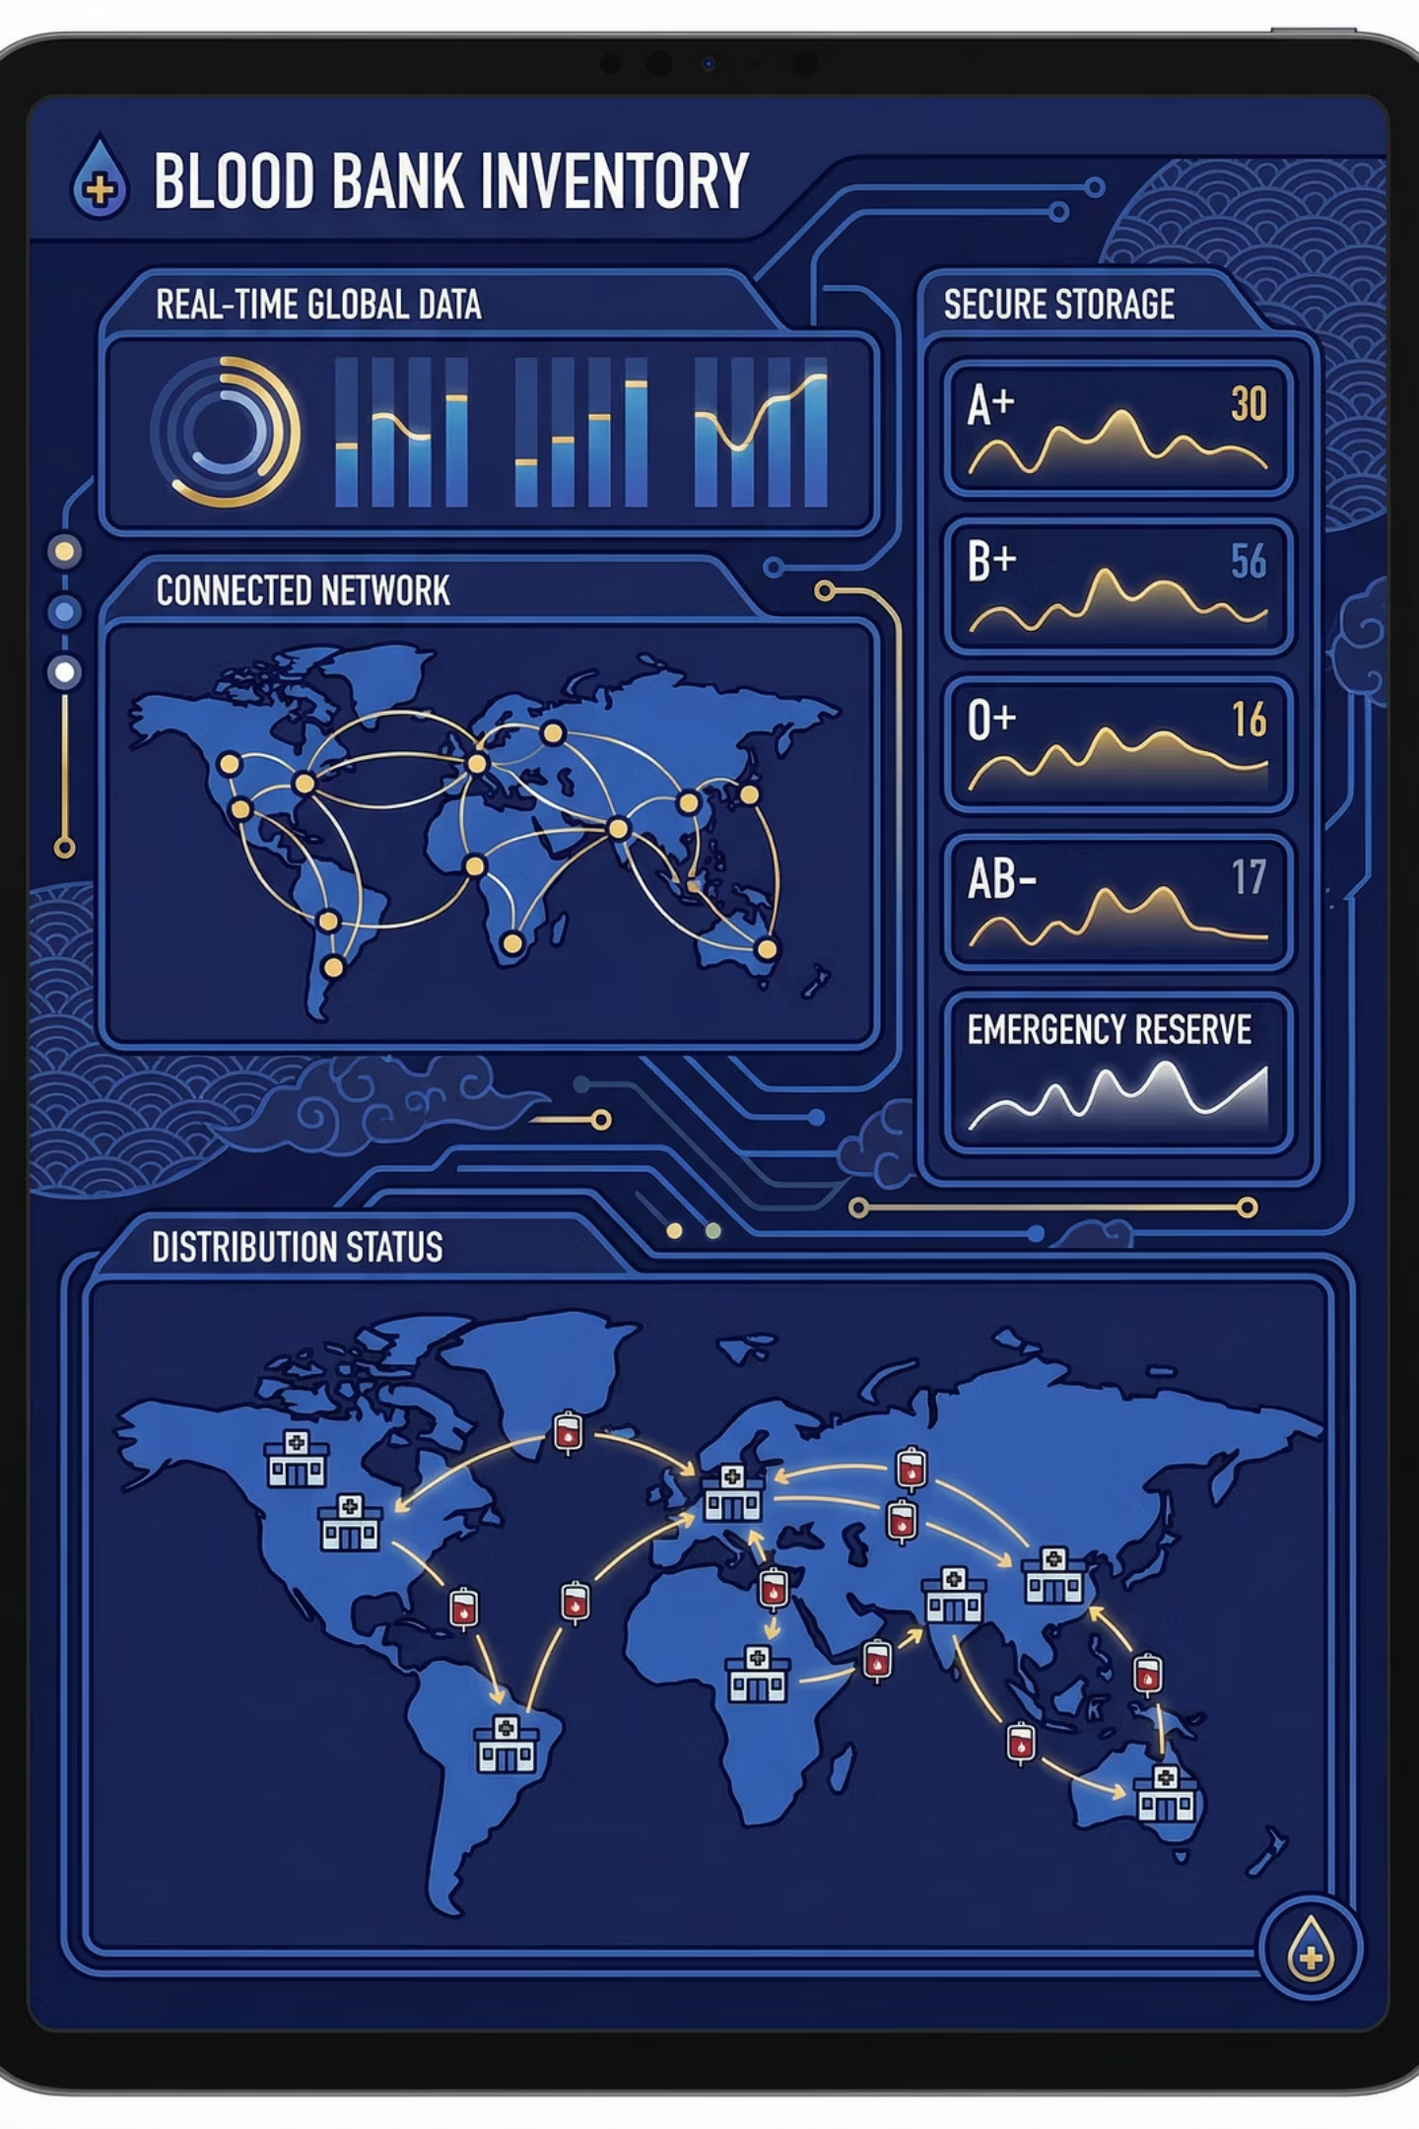



Our Solution: A Digital Blood Bank
Real-time Availability
Instant updates on blood stock.
Connect Stakeholders
Linking donors, recipients, and blood banks.
Reduce Response Time
Faster action in critical emergencies.

Slide 6




System Overview: Web-Based & Accessible
Our web-based blood bank management system is designed for universal access and ease of use.
Accessible from any device
User-friendly interface
Web-Based
Secure and reliable platform
Multi-Device
Secure

Slide 7

Technology Powering Our Platform
Frontend
1
Tailwind CSS for a responsive and interactive UI.
Backend
2
JS for business logic and user request management.
Database
3
Firebase for secure data storage and consistency , and for authentication

Slide 8






Key Modules: Frontend, Backend, Database
Backend
Manages logic, requests, and database connection.
Frontend
Responsive, interactive, and optimized for performance.
Database
Stores user, donor, and blood availability data securely.

Slide 9




Robust Security Features
Protecting sensitive user data is paramount. Our system employs advanced security measures.
JWT Authentication
Access Control
Secure token-based access.
Ensuring authorized user access.
Data Protection
Safeguarding all sensitive information.

Slide 10

Transforming Blood Bank Operations
Faster
Reduced
Efficient
Emergency Response
Blood Wastage
Management
Quick access to vital blood supplies.
Optimized inventory management.
Streamlined blood bank operations.

Slide 11
Key Takeaways
Identified a real-world healthcare problem: reactive blood inventory planning leading to shortages during emergencies.
Applied SDLC thinking to move from problem identification → requirement analysis → solution design → outcome evaluation.
Defined functional requirements (FRD) such as demand prediction, inventory recommendations, alerts, and human-in-the-loop decision support.
Framed a clear project charter with objective, scope, stakeholders, feasibility, and measurable success criteria.
Built a strong business case highlighting operational efficiency, cost reduction, reduced wastage, and social impact.
Ensured practical implementation by using existing hospital and blood bank data instead of hypothetical systems.
Maintained ethical and reliable design by supporting human decision-making rather than replacing it.
Exposed course tools (NapkinAI, NotebookLM, Claude, Prompt Engineering) to visualize, document, and communicate solutions effectively.

Slide 12


Conclusion: Saving Lives, Digitally
Our web application digitizes blood bank operations, improving healthcare support and ultimately helping to save lives.
Thank You
We are happy to answer your questions.

